Slide 1

Integer Programming: Branch and Bound
MTH 564 – Mathematical Modeling

Slide 2

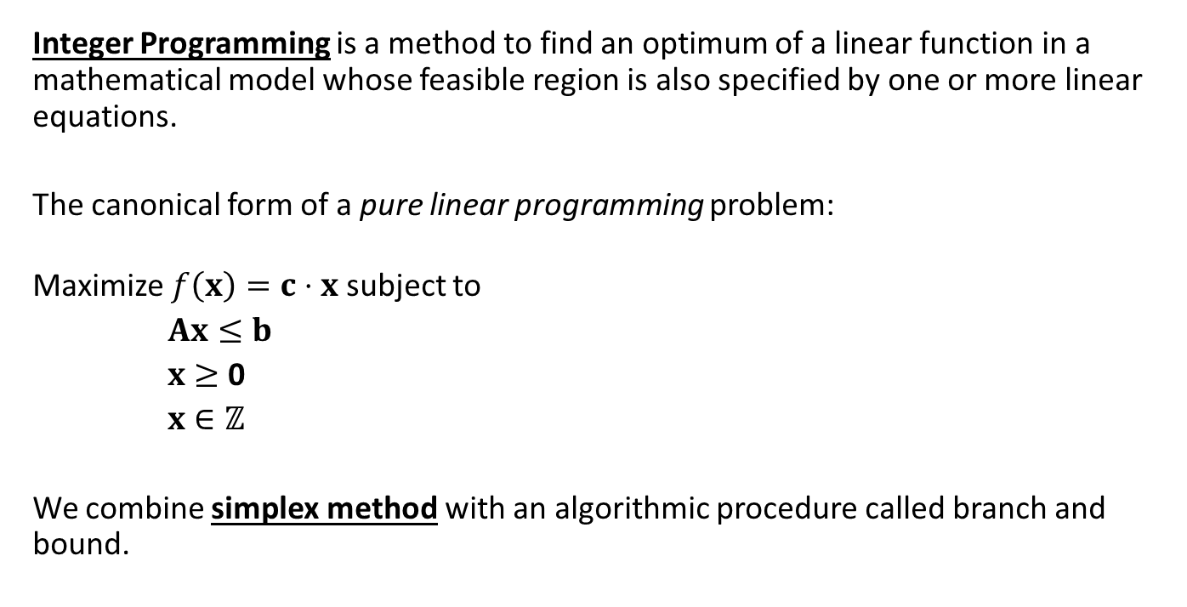
Integer Programming
Integer Programming is a method to find an optimum of a linear function in a mathematical model whose feasible region is also specified by one or more linear equations.
The canonical form of a pure linear programming problem:
Maximize $f\left(x\right)=c⋅x$ subject to
$Ax≤b$
$x≥$ 0
$x∈ℤ$
We combine simplex method with an algorithmic procedure called branch and bound.

Slide 3
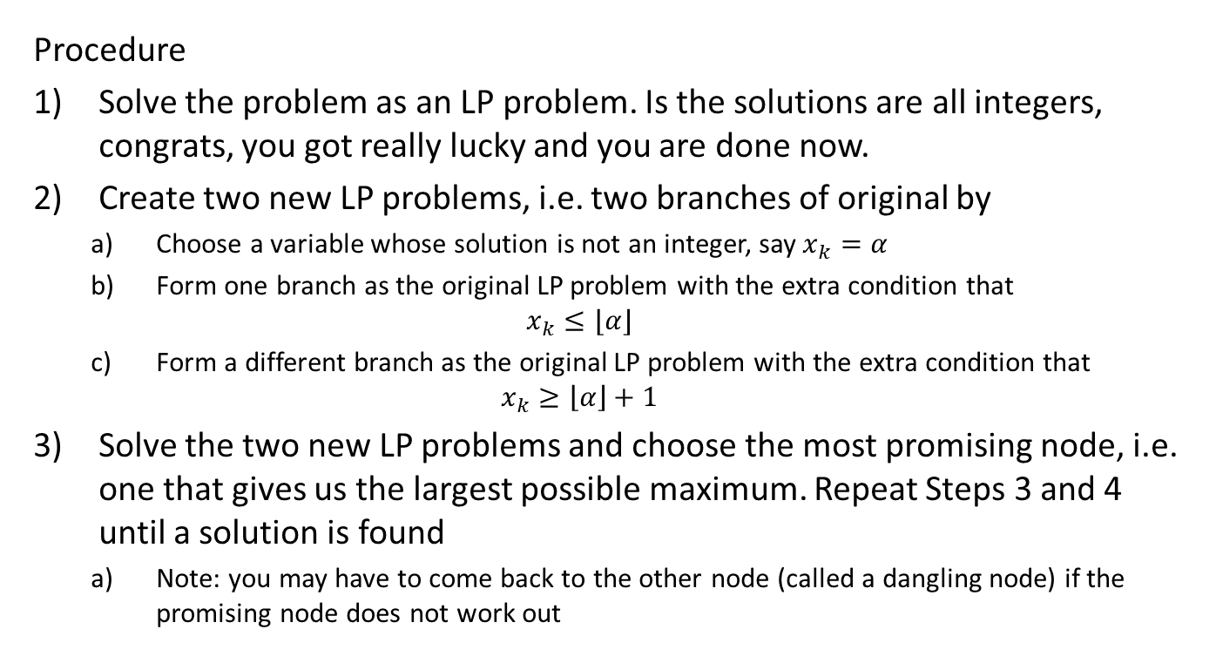
Branch and Bound: General Idea
Procedure
Solve the problem as an LP problem. Is the solutions are all integers, congrats, you got really lucky and you are done now.
Create two new LP problems, i.e. two branches of original by
Choose a variable whose solution is not an integer, say $x_{k}=α$
Form one branch as the original LP problem with the extra condition that $x_{k}≤⌊α⌋$
Form a different branch as the original LP problem with the extra condition that $x_{k}≥\left\lfloor α\right\rfloor +1$
Solve the two new LP problems and choose the most promising node, i.e. one that gives us the largest possible maximum. Repeat Steps 3 and 4 until a solution is found
Note: you may have to come back to the other node (called a dangling node) if the promising node does not work out

Slide 4
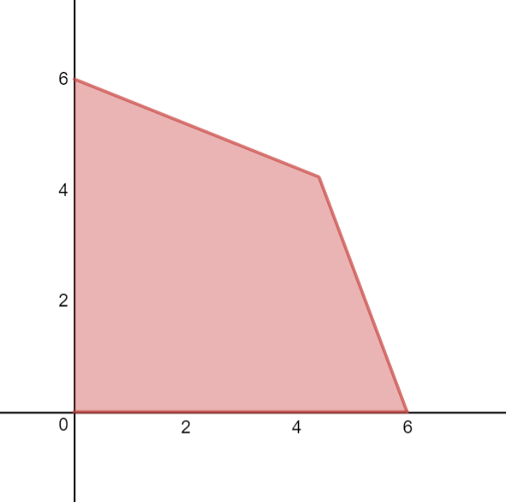

Branch and Bound: Example
Example:
Maximize $z=7x_{1}+3x_{2}$
subject to
$$2x_{1}+5x_{2}≤30$$
$$8x_{1}+3x_{2}≤48$$
$$x_{1},x_{2}≥0 x_{1},x_{2}∈ℤ$$
Python: ipexample.py

Slide 5



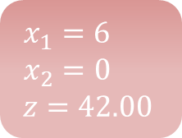
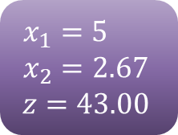

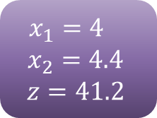
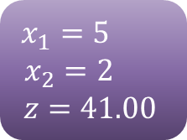

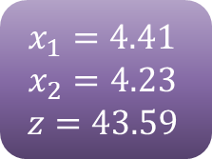
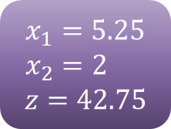

Example
No Solution
$$x_{2}≥3$$
$$x_{1}=5$$
$$x_{2}=2.67$$
$$z=43.00$$
$$x_{1}=6$$
$$x_{2}=0$$
$$z=42.00$$
$$x_{1}≥5$$
$$x_{1}≥6$$
$$x_{1}=4.41$$
$$x_{2}=4.23$$
$$z=43.59$$
$x_{1}=5.25$
$$x_{2}=2$$
$$z=42.75$$
$$x_{2}≤2$$
$x_{1}=4$
$$x_{2}=4.4$$
$$z=41.2$$
$$x_{1}=5$$
$$x_{2}=2$$
$$z=41.00$$
$$x_{1}≤4$$
$$x_{1}≤5$$
Note that we get to prune a lot of branches. For example, we don’t have to check values for the entire bottom of the tree.
This can greatly reduce the total number of integer combinations we have to check.

Slide 6
Branch and Bound: Pseudocode
L ={Original LP} # list of nodes
max_z = solution of original LP # current max to problem
while L is not empty:
node = pick a element from the list and solve LP
if node is infeasible
do not branch
else if the node solution are all integers
do not branch
compare to the best solution
update the best integer solution if this is better
else if node solution are not all integral
if the objective value is worse
do not branch
else
create two new branches and add to the list L
Return the best integer solution.

